Slide 1
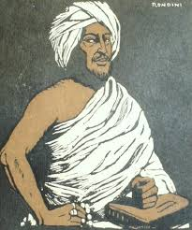
Sayid Mohamed Abdulle Hassan
The Dervish Leader and His Fight Against Colonial Rule

Slide 2
Essential Question
How does the legacy of Sayid Mohamed Abdulle Hassan inform our understanding of resistance against colonialism and contemporary injustices in the U.S.?

Slide 3

Learning Targets
I can explain the life and contributions of Sayid Mohamed Abdulle Hassan in the context of Somali resistance to colonialism.
I can analyze the similarities and differences between colonial oppression faced by Somali people and contemporary oppression experienced by minorities in America.
I can engage with a guest speaker to gain personal insights into the legacy of Sayid Mohamed Abdulle Hassan and the impact of colonialism on communities today.

Slide 4
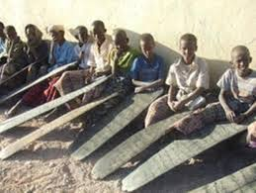
Early Life
Born: April 7, 1856 in Northern Somalia.
Education: Memorized the Quran at a young age. He furthered his Islamic learning across Harar, Mogadishu, and Sudan.
Pilgrimage to Mecca (1894) Undertook the pilgrimage (Hajj) to Mecca.
Influence: During this journey, he was profoundly impacted by Abd al‑Salām al‑Sālih, the founder of the Ṣaliḥiyya Sufi order.
Notes:
https://www.britannica.com/topic/history-of-Somalia

Slide 5
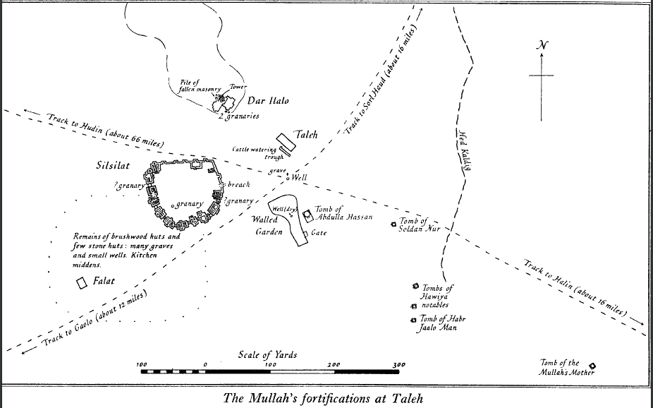
Rise to Leadership
Return to Somalia: (1895) Hassan returned, built a mosque, and began preaching against the British colonial presence and Christian missionary activities.
Called for the expulsion of British colonizers and missionaries
Religious Focus: Urged Somalis to strictly follow Islamic faith
Influence: Attracted a devoted following known as the Dervishes through powerful speeches and poetry.
Notes:
(1895) Hassan returned to Berbera

Slide 6
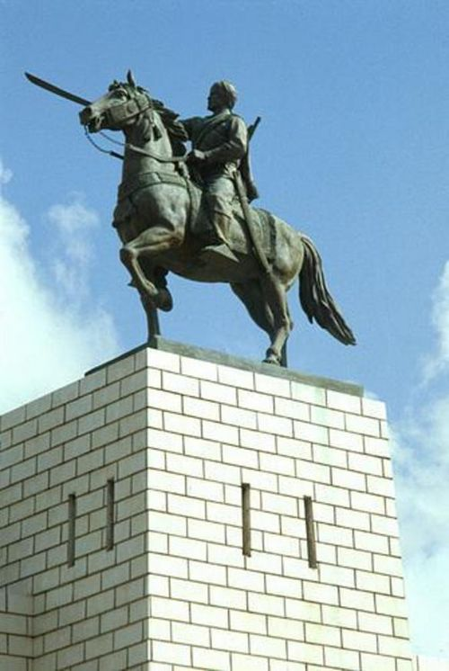
Declaration of Jihad
1989: Hassan declared a holy war (jihad) against colonial powers and their Somali allies.
He faced military campaigns from British, Ethiopian, and Italian forces from 1900 to 1904.
Notes:
Consider having students compare and contrast the Jihadists of today like Al Qaeda, Al-Shabab in Somalia, and ISIS with Sayyid Mohamed Abdulle Hassan. Also discuss imperialism back then and imperialism today.

Slide 7
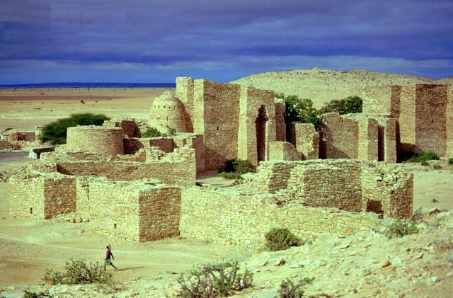
Establishment of Theocratic State
Truce (1905): Established a temporary agreement with the British and the Italians, allowing for the creation of a small theocratic state in the Italian protectorate of Somalia.
Resumed Conflict (1908): The brief truce ended, prompting Hassan to resume his resistance against colonial powers.
The ruins of Sayyid Mohamed capital and his fortress in Taleeh. It was destroyed by British at the end of WWI
Notes:
Ask students if they know: What is a theocracy?

Slide 8
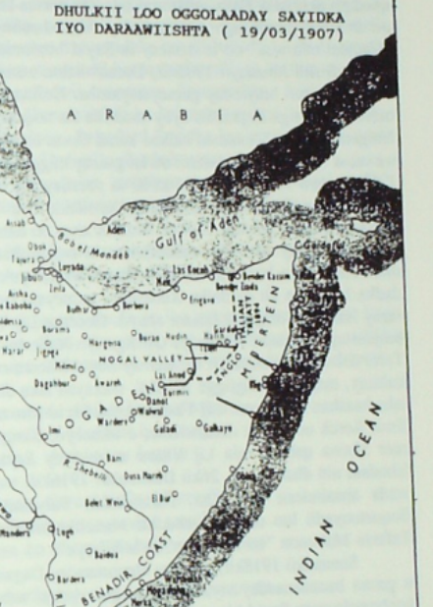
Key Victories
and Challenges
Battle of Dulmadobe (1913): Hassan's Dervish force of about 2,750 ambushed and mostly defeated a unit of the British Somali Camel Constabulary, killing their commander, Colonel Richard Corfield.
The map shows the area in which Hassan was allowed to rule.
Notes:
Ask students to search for factors contributing to his victories and defeats and the challenges he faced.
Note that Hassan faced severe military opposition despite early successes

Slide 9
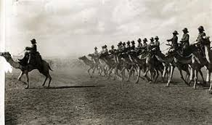
Final Years and Legacy
British Assault: In early 1920, the British bombed the Dervish stronghold at Taalex (Taleh).
Fleeing and Death: Hassan fled to the Ogaden region and died of influenza shortly thereafter.
Notes:
Legacy: Remembered as a key figure in the fight against colonialism in Somalia.
Impact: Sayid Mohamed Abdulle Hassan's legacy continues to inspire Somali nationalism and resistance against colonialism.

